Slide 1
Delivering a Comprehensive Package of
HIV Prevention, Care, and Treatment Services for Key Populations: FHI 360 LINKAGES Malawi Project
Gift Kamanga, Louis Banda, Laston Banda, Christina Banda, Maria Mkandawire, Stanley Kalyati, Elizabeth Mpunga, McPherson Gondwe, Melchiade Ruberintwari, Dorica Boyee, Navindra Persaud, Christopher Akolo
Presented at AIDS 2018, Amsterdam, The Netherlands, July 26, 2018
Abstract: THAC0201

Slide 2
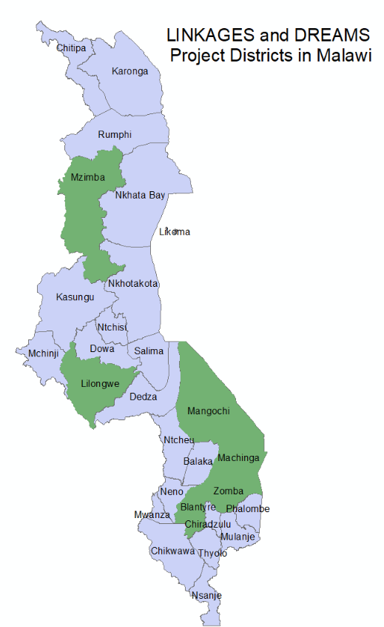
Malawi’s HIV Burden
HIV prevalence
  General population 8.8%
  FSWs - 62.7%
  MSM - 17.5%
MOH commitment to services to KPs through National HIV Prevention Strategy and HIV and AIDS strategic Plan 2015-2020
PEPFAR-funded LINKAGES project came in to meet the HIV prevention, care, and treatment needs of KPs

Slide 3
Looking Back: HIV Cascade Assessment
FSW in Lilongwe District (March 2016)

Slide 4
The Winning Approach
UNDERSTANDING THE POPULATION:
Programmatic mapping, PLACE study
PEER LEADERSHIP FOCUS:
Trained in microplanning, routine mentorship
EFFECTIVE ENGAGEMENT OF
KEY PLAYERS IN PROGRAMING:
Government structures-all levels,
Key populations,
civil society organizations
ACCESS TO COMPREHENSIVE PACKAGE OF SERVICES FOR KPS Prevention messages, STI screening and treatment, violence prevention and mitigation, condom and lubricants use,
HIV testing, ART, retention, viral suppression

Slide 5
Understanding the Population: Programmatic Mapping Results for FSW
Percent Mapping Estimate Increase | FY15 Clustered Hotspots | FY 17 Clustered Hotspots | Percent Hotspot Number Increase | FY15 FSW Estimated population in hotspots | FY17 FSW Estimated population in hotspots | Percent Estimated population Increase
Mangochi | - | 47 | - | 841 | 1,024 | 22%
Blantyre | 87 | 133 | 53% | 2,315 | 3,151 | 36%
Lilongwe | 34 | 69 | 200% | 2,625 | 3,261 | 24%
Mzuzu | 39 | 69 | 77% | 852 | 1,527 | 79%
Machinga | 19 | 23 | 21% | 430 | 867 | 201%
Zomba | 32 | 36 | 13% | 764 | 1,038 | 36%
Total | 279 | 377 | 35% | 7,827 | 10,868 | 39%

Slide 6
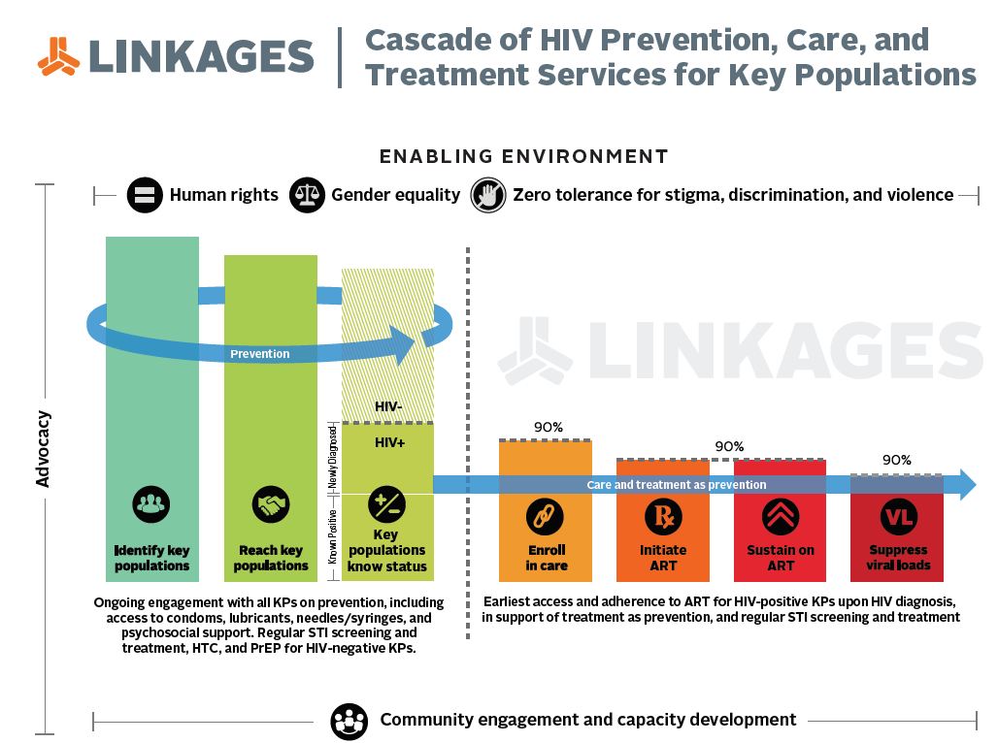
Framework for LINKAGES Cascade of Services and Stakeholder Coordination
v
Malawi Police Service
CHREA
Other legal and advocacy partners
PLACE study
Outreach teams
District Health Offices (DHOs)
Private clinics
Baylor Children’s Foundation
Central hospitals
DREAM Lab
Lighthouse
Pakachere IHDC ● YONECO ● CEDEP
Ministry of Health (DHA) ● National AIDS Commission

Slide 7
Preparing Community and Health Care Workers to Improve Services to KPs
Trained 354 PEs, 193 PNs and 32 ORWs as frontline workers to reach KPs services
Established 79 support groups for KP PLHIV
Trained 33 program staff plus peer leaders on GBV screening and crisis management
Trained a combination of 62 HCWs in
public and private clinics on KP-friendly service provision

Slide 8




Differentiated Service Delivery Modalities
Drop-in Centers (DICs): combination of services and safe space for KPs
Outreach Clinics
Hybrid (public and private health facilities): facilities where service provision largely depends on other stakeholders
Enhanced peer outreach approach
(EPOA)

Slide 9
A New Story for the HIV Cascade
Cascade for FSWs: October 2017‒March 2018

Slide 10
Trend in Knowing HIV Status and
Linkage to ART among FSW

Slide 11
HIV Case Finding Trend among MSM (Poster THPEC 251)

Slide 12
Summary and Lessons Learned
The following attributes are key to success in
KP programing:
MOH leadership and buy-in for KP programing
Continuous engagement of stakeholders: DHO, police, district executive leadership
Empowered KP members
Evidenced based program - regular mapping and microplanning
Differentiated approach increase access to services
Implementers’ friendliness and commitment to serving KPs

Slide 13






Acknowledgments

Slide 14
Stay Connected with LINKAGES
There are several ways to stay involved with LINKAGES’ work, as well as new evidence, publications, and tools related to HIV prevention, care, and treatment among key populations and their partners.

Slide 15


Stay Connected with LINKAGES
Follow LINKAGES on Twitter:
www.twitter.com/LINKAGESproject
Like the project on Facebook:
www.facebook.com/LINKAGESproject
Subscribe to the LINKAGES blog
www.linkagesproject.wordpress.com
Subscribe to The LINK, LINKAGES’s quarterly
project e-newsletter
Check out LINKAGES’s quarterly research digest

